Slide 1
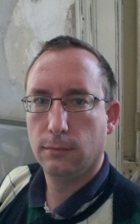

Péter JOLÁNKAI
4th DEMO
27.10.2017
Pallida Cohort - Static Class
Hardware programing

Slide 2
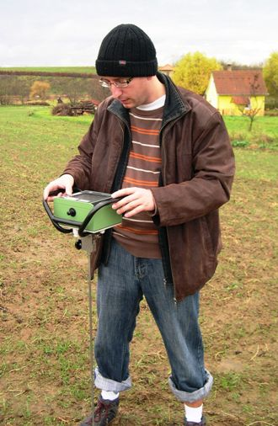
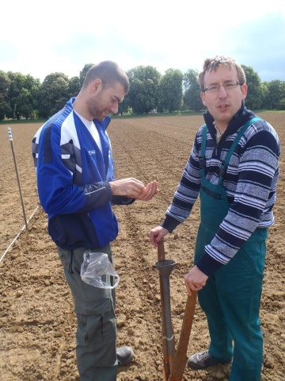
Introduction:
I am an agronomist, with university research background
and lecturing

Slide 3
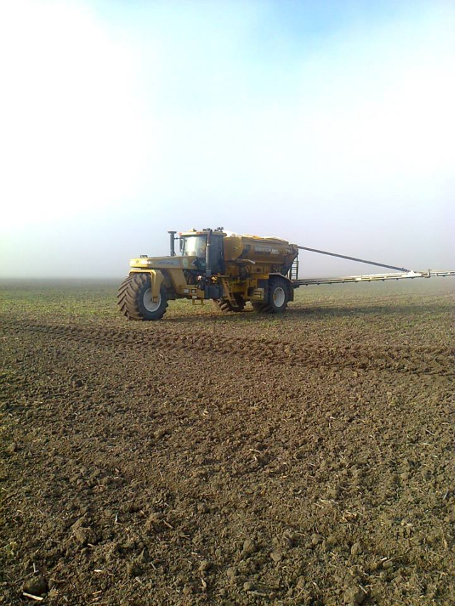

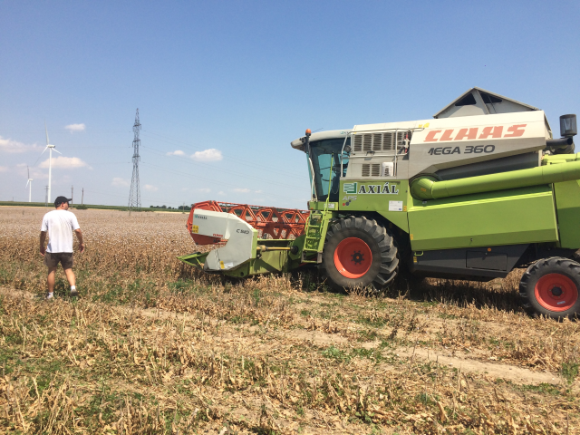
Later I worked for a company
as an agronomist
for producing medical plants

Slide 4
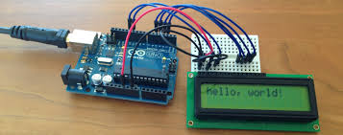
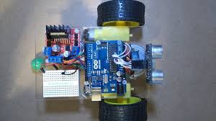
After playing with arduino I decided to join the hardvare
programmer course of Greenfox Academy

Slide 5

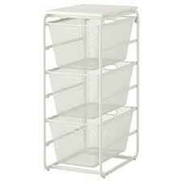
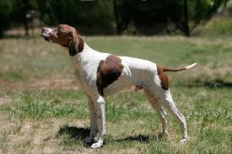
This weeks activity:

Slide 6
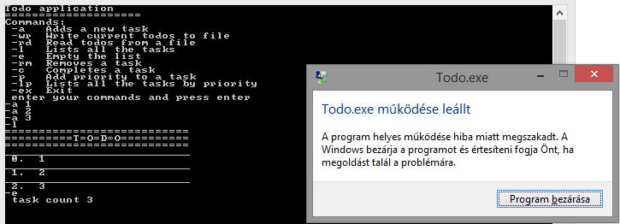

Slide 7

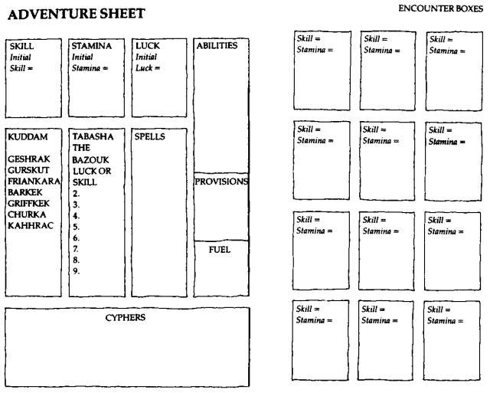

Slide 8
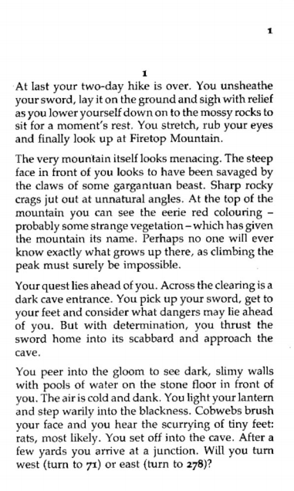

Slide 9


Slide 10
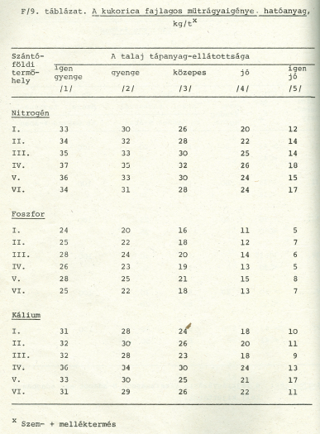

Slide 11

Thank you for your attention!

